Slide 1
CSC 112: Computer Operating Systems Lecture 4 Deadlocks Exercises
Department of Computer Science,
Hofstra University
Acknowledgement: Lecture slides based on UC Berkeley CS 162: Operating Systems and System Programming

Slide 2

Banker’s Algorithm: 4 philosophers each holding his left fork
Max
Allocation
Need
0
1
0
1
$$R−C$$
0
1
0
1
1
1
Available resources after completion of each process
Total
Available
 | R1 | R2 | R3 | R4 | R5
 | 0 | 0 | 0 | 0 | 1
Suppose we have 5 philosophers P1-P5, and 5 forks R1-R5; philosopher Pi has left fork Ri, and right fork R(i+1)%5. Philosophers P1-P4 each is holding his left fork.
Run Banker’s algorithm to check if the current state is safe. If yes, give a safe sequence of process completions and fill in the table with the sequence of process completions without deadlock, and available resources after the completion of each process.

Slide 3
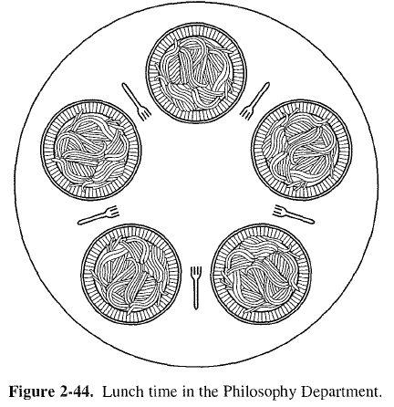
Banker’s Algorithm: 4 philosophers each holding his left fork ANS
Yes, current state is safe, and a safe sequence is P4, P3, P2, P1, P5
5
4
Available resources after completion of each process
5
3
 | R1 | R2 | R3 | R4 | R5
 | 0 | 0 | 0 | 0 | 1
P4 | 0 | 0 | 0 | 1 | 1
P3 | 0 | 0 | 1 | 1 | 1
P2 | 0 | 1 | 1 | 1 | 1
P1 | 1 | 1 | 1 | 1 | 1
P5 | 1 | 1 | 1 | 1 | 1
1
3
1
2
2
Notes:
https://people.eecs.berkeley.edu/~kubitron/courses/cs162-F07/exams/fa07mt1-solutions.pdf
The lawyers are so busy talking that they can only grab one chopstick at a time. Design a deadlock-free algorithm using monitors and Bankers algorithm.

Slide 4
Banker’s Algorithm: 5 philosophers each holding his left fork
Max
Allocation
Need
0
1
0
1
0
1
0
1
1
Total
Available
Run Banker’s algorithm to check if the current state is safe.
ANS: It is not safe, as no process can run to completion based on Need matrix and Available vector.

Slide 5
Multi-Armed Lawyers
Consider a large table with identical multi-armed alien lawyers. There is a pile of chopsticks at the center of the table. In order to eat, a lawyer must have one chopstick in each hand. Assume total number of chopsticks >= number of hands of each lawyer, so at least one lawyer can eat.
It is not a generalization of the 2-armed Dining Philosophers problem. Since the chopsticks are in a pile at center of the table, we should model them as a single resource with multiple instances, instead of multiple resources for the Dining Philosophers, where each fork (chopstick) has a fixed position in-between two philosophers. Hence the R and C matrices have a single column.
Ack: this example is taken from UC Berkeley CS162 course.
Notes:
https://people.eecs.berkeley.edu/~kubitron/courses/cs162-F07/exams/fa07mt1-solutions.pdf
The lawyers are so busy talking that they can only grab one chopstick at a time. Design a deadlock-free algorithm using monitors and Bankers algorithm.

Slide 6
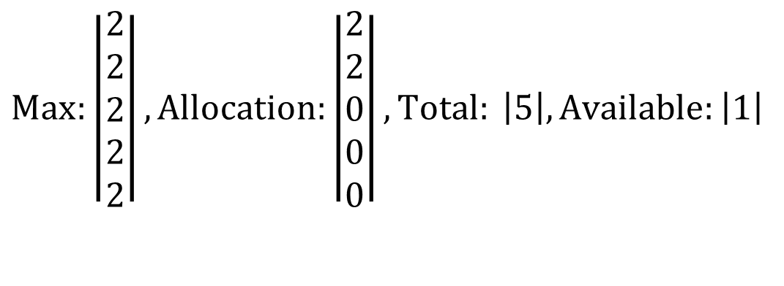
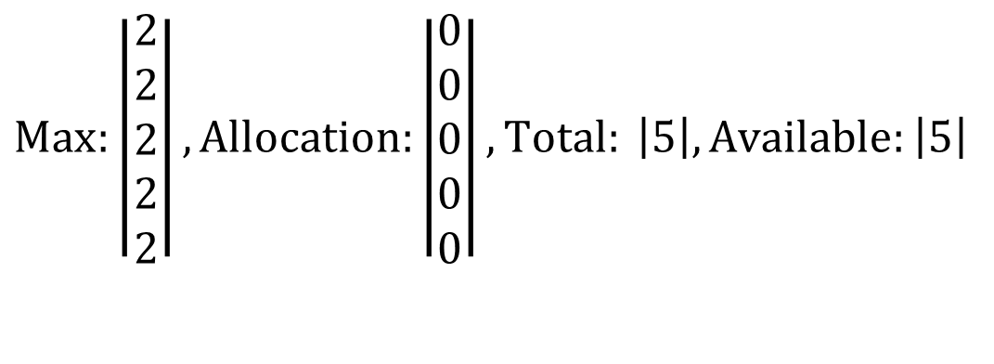
Example: 5 Lawyers, each with 2 arms, 5 chopsticks
$$Max:\left|\begin{matrix}2 \\ 2 \\ 2 \\ 2 \\ 2\end{matrix}\right|, Allocation:\left|\begin{matrix}0 \\ 0 \\ 0 \\ 0 \\ 0\end{matrix}\right|, Total: \left|5\right|, Available:\left|5\right|$$
Initially, all chopsticks are free.
$$Max:\left|\begin{matrix}2 \\ 2 \\ 2 \\ 2 \\ 2\end{matrix}\right|, Allocation:\left|\begin{matrix}2 \\ 2 \\ 0 \\ 0 \\ 0\end{matrix}\right|, Total: \left|5\right|, Available:\left|1\right|$$
Two lawyers each grab two chopsticks and start eating. No other lawyers can eat.

Slide 7
Quiz: Dining Lawyers I
If each lawyer has 2 arms, and there is a pile of chopsticks at the center of the table. Assume there are at least 2 chopsticks, so at least one lawyer can eat. Each lawyer follows the following steps:
(1) Pick up a chopstick
(2) Pick up another chopstick
(3) Eat
(4) Return both chopsticks to the pile
Q: Can the system be deadlocked?

Slide 8
Quiz: Dining Lawyers I Answer
ANS: No deadlocks, since there is only one type of resource, so it is not possible to have circular waiting.
Notes:
A

Slide 9
Quiz: Dining Lawyers II
If each lawyer has 2 arms, and there is a pile of knives and forks at center of the table. Assume there are at least 1 knife and 1 fork, so at least one lawyer can eat. Each lawyer follows the following steps:
(1) Pick up a knife
(2) Pick up a fork
(3) Eat
(4) Return the knife and fork to the pile
Q: Can the system be deadlocked?

Slide 10
Quiz: Dining Lawyers II Answer
ANS: No deadlocks, since it’s not possible to have circular waiting.
All lawyers follow the same resource acquisition order:
1. Knife
2. Fork
Since lawyers do not wait for resources held by others in a cyclic manner, no circular dependency forms.
Example: If all knives are taken, lawyers without knives wait for returned knives. Those with knives either acquire forks (if available) or wait for forks to be returned. With at least one fork in the system, progress is guaranteed once utensils are released.
Resource 2 (a knife) held by Thread 2
1 knife
Resource 2 (a knife) requested by Thread 2
P1
P2
Resource 1 (a fork) requested by Thread 2
1 fork
Resource 1 (a fork) held by Thread 2
This deadlock scenario is not possible under the fixed resource acquisition order: 1. Knife 2. Fork
Notes:
A

Slide 11
Quiz: Dining Lawyers III
If each lawyer has 4 arms, and there is a pile of knives and forks at center of the table. Assume there are at least 2 knives and 2 forks, so at least one lawyer can eat. Each lawyer follows the following steps:
(1) Pick up 2 knives atomically
(2) Pick up 2 forks atomically
(3) Eat
(4) Return the knives and forks to the pile
Q: Can the system be deadlocked?

Slide 12
Quiz: Dining Lawyers III Answer
ANS: No deadlocks, since it’s not possible to have circular waiting.
All lawyers follow the same resource acquisition order:
1. Two knives
2. Two forks
Since lawyers do not wait for resources held by others in a cyclic manner, no circular dependency forms.
Resource 2 (2 knives) held by Thread 2
2 knives
Resource 2 (2 knives) requested by Thread 2
P1
P2
Resource 1 (2 forks) requested by Thread 2
2 forks
Resource 1 (2 forks) held by Thread 2
This deadlock scenario is not possible under the fixed resource acquisition order: 2 knives, 2 forks
Notes:
A

Slide 13
Quiz: Dining Lawyers III
If each lawyer has 4 arms, and there is a pile of knives and forks at center of the table. Assume there are at least 2 knives and 2 forks, so at least one lawyer can eat. Each lawyer follows the following steps:
(1) Pick up a knife
(2) Pick up another knife
(3) Pick up a fork
(4) Pick up another fork
(5) Eat
(6) Return the knife and fork to the pile
Q1: Can the system be deadlocked?
Q2: What if each lawyer may have a different number of arms, and may request a different ratio of knives vs. forks?

Slide 14
Quiz: Dining Lawyers III Answer
ANS1: Yes, since requests for each resource type (knife or fork) are not granted atomically. Need Banker’s algorithm to detect (potential) deadlocks.
Consider 2 lawyers, and a total of 2 knives and 2 forks available. If each lawyer picks up a knife, the system is deadlocked.
Recall: “Define a total order of resources; If a thread holds certain resources, it can subsequently request only resources that follow the types of held resources in the total order.” Since all knives are the same and not numbered, you cannot form a total order like “request knife 1 before knife 2”. If a lawyer requests a knife while holding a knife, there may be circular waiting.
ANS2: The solution is basically the same, except implementation of Banker’s algorithm needs to take into account this factor, e.g., have an array of variables NumArms[] instead of a single variable NumArms, and so on.
Resource 2 (a knife) held by Thread 2
1 knife
Resource 2 (a knife) requested by Thread 2
P1
P2
Resource 1 (a knife) requested by Thread 2
1 knife
Resource 1 (a knife) held by Thread 2
This deadlock scenario is possible under the resource acquisition order: a knife, a knife, a fork, a fork.
Notes:
A: The solution is basically the same, except implementation of Banker’s algorithm needs to take into account this factor, e.g., have an array of variables NumArms[] instead of a single variable NumArms, and so on.

Slide 15

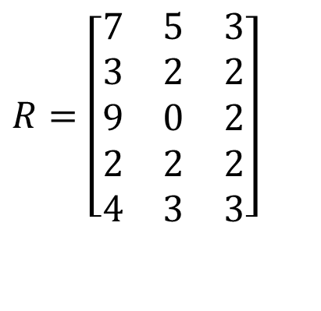

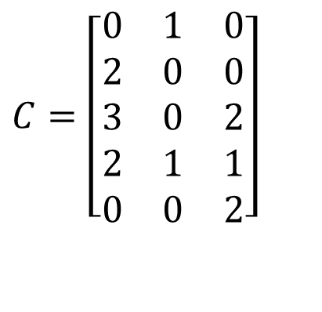
Quiz: Banker’s algorithm
4 processes P0 through P4; 4 resource types with 10, 5, 6, 5 instances each.
Is the current system state safe?
Max
Allocation
$$R=\left[\begin{matrix}7 & 5 & 3 \\ 3 & 2 & 2 \\ 9 & 0 & 2 \\ 2 & 2 & 2 \\ 4 & 3 & 3\end{matrix}\right]$$
$$C=\left[\begin{matrix}0 & 1 & 0 \\ 2 & 0 & 0 \\ 3 & 0 & 2 \\ 2 & 1 & 1 \\ 0 & 0 & 2\end{matrix}\right]$$
Total
Available
$$E=\left[\begin{matrix}10 & 5 & 7\end{matrix}\right]$$
$$A=\left[\begin{matrix}3 & 3 & 2\end{matrix}\right]$$

Slide 16

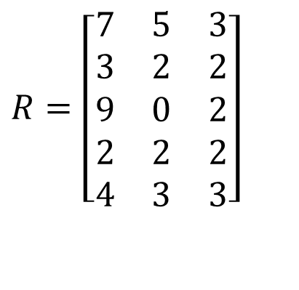
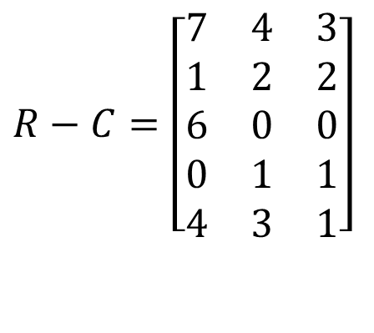

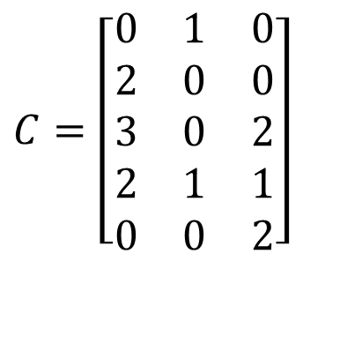
Quiz Solution: Banker’s algorithm
First compute the Resources needed matrix R-C and Resources available vector A.
We can verify that the system is in a safe state, with a possible feasible execution sequence P2, P4, P5, P3, P1.
(R-C)₂ = [1, 2, 2] <= A = [3, 3, 2]. Run P2 to completion and free its resources. Now A = [3, 3, 2] + [3, 2, 2] = [6, 5, 4]
(R-C)₄ = [6, 0, 0] <= A = [6, 5, 4]. Run P4 to completion and free its resources. Now A = [6, 5, 4] + [2, 2, 2] = [8, 7, 6] (We can also run P4 before P2.)
We can run the remaining processes P5, P3, P1 in any order since the available resources are enough to satisfy each processes’ needed resources.
Max
Allocation
Need
$$R=\left[\begin{matrix}7 & 5 & 3 \\ 3 & 2 & 2 \\ 9 & 0 & 2 \\ 2 & 2 & 2 \\ 4 & 3 & 3\end{matrix}\right]$$
$$C=\left[\begin{matrix}0 & 1 & 0 \\ 2 & 0 & 0 \\ 3 & 0 & 2 \\ 2 & 1 & 1 \\ 0 & 0 & 2\end{matrix}\right]$$
$$R−C=\left[\begin{matrix}7 & 4 & 3 \\ 1 & 2 & 2 \\ 6 & 0 & 0 \\ 0 & 1 & 1 \\ 4 & 3 & 1\end{matrix}\right]$$
Total
Available
$$E=\left[\begin{matrix}10 & 5 & 7\end{matrix}\right]$$
$$A=\left[\begin{matrix}3 & 3 & 2\end{matrix}\right]$$

Slide 17
Quiz: Deadlocks II
Is there a possible deadlock?
Yes, there is a deadlock. Consider the following interleaving:
thread 1: L1.wait();
thread 2: L3.wait();
thread 3: L2.wait();
Now there is a circular wait condition:
thread 1 waiting for L2 (held by thr. 3) → thr. 2 waiting for L1 (held by thr. 1) → thr. 3 waiting for L3 (held by thr. 2).
Solution: each thread should acquire locks in the same order, say, L1, L2, L3.
1 Semaphore L1=1, L2=1, L3=1;
2
// Thread 1:
L1.wait();
L2.wait();
// critical section requiring L1 and L2 locked.
L2.post();
L1.post();
9
// Thread 2:
L3.wait();
L1.wait();
// critical section requiring L3 and L1 locked.
L1.post();
L3.post();
16
// Thread 3:
L2.wait();
L3.wait();
// critical section requiring L2 and L3 locked.
L3.post();
L2.post();

